Slide 1

TITLE
British Airways
BA Reviews (Nov 2024): The Sky’s the Limit

Slide 2

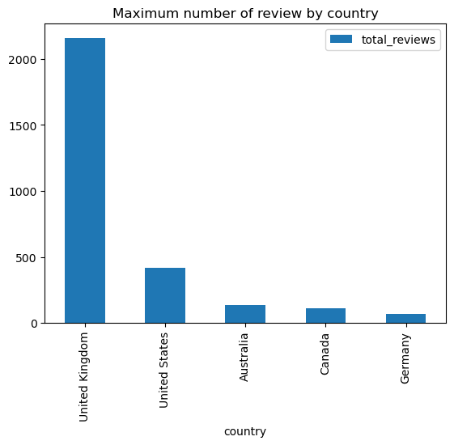
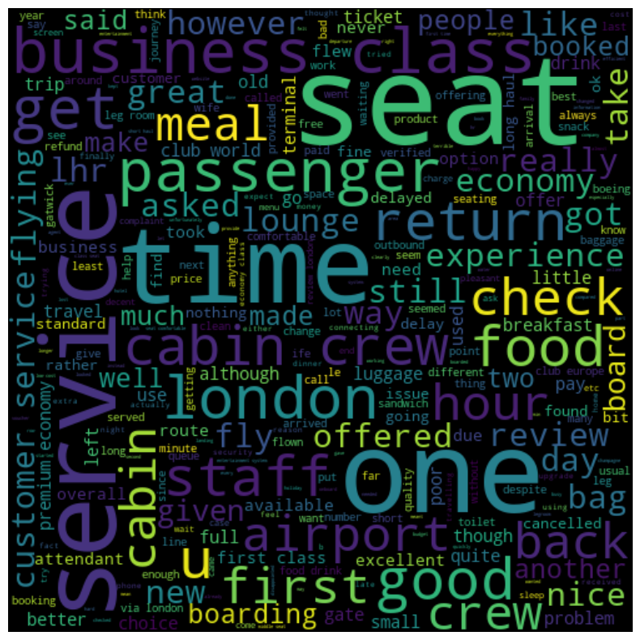
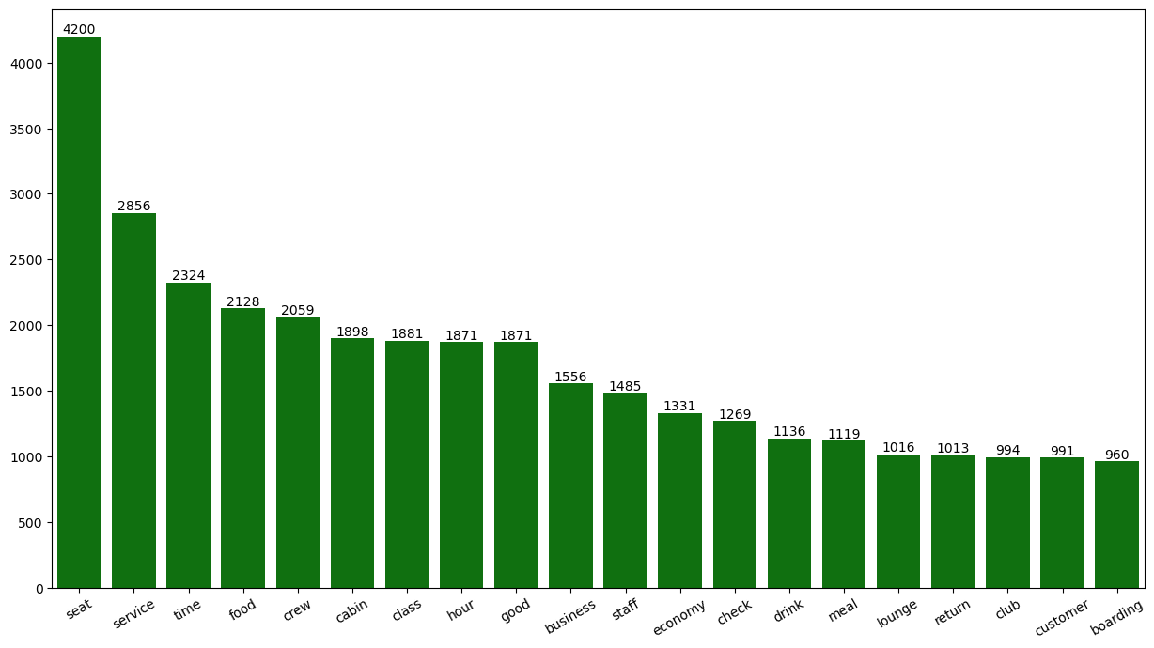
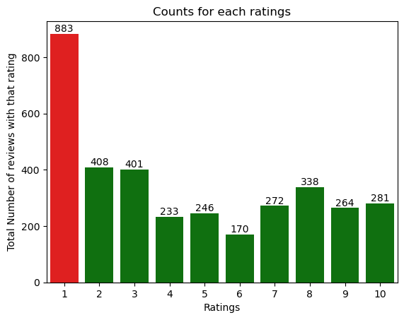
The total Reviews collected were 3500
Reviews come from 71 countries
The overall Average rating is 4.54
What customers are unhappy and unsatisfied about for different rating classes:
7-10 ratings wrote about Business class seats being small and old, poor customer service and time landed slightly early.
4-6 ratings faced problems with TV screens being small, extremely poor customer service and extra payment for the legroom seats.
1-3 ratings wrote: worst long haul business and middle seat blocking.
As they liked the seats and the food.
All Customers liked the seats, time, cabin crew and meal.
Customer feedback shows seating, timing, cabin crew, and meal satisfaction. To improve, focus on enhancing business class seating and time-related preferences, upgrading middle and business class seats, and improving in-flight music equipment. Additionally, streamline refund processes to elevate customer service..

